Slide 1
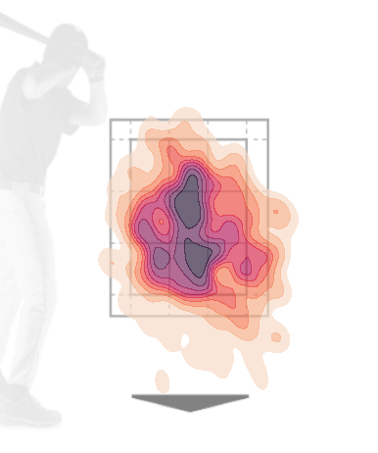
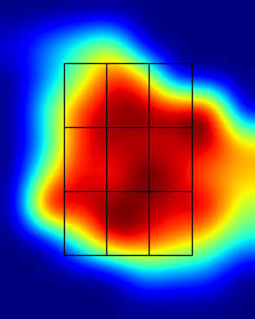
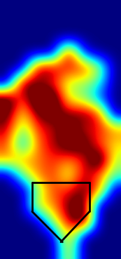
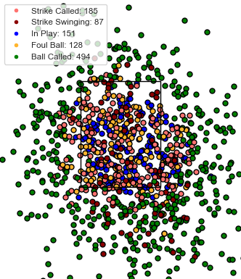


Dylan Crews
Hitter Report
2023 Season
AVG EV | MAX EV | Swing % | Chase % | InZoneSwing % | Strikeout % | BB+HBP/K | BABIP | wOBA
91.1 | 112.8 | 35.0% | 12.7% | 64.9% | 14.1% | 1.80 | .441 | .522
PA | AB | H | 2B | 3B | HR | RBI | BB | HBP | K | AVG | OBP | SLG | OPS
249 | 186 | 75 | 9 | 1 | 15 | 53 | 51 | 12 | 35 | .403 | .554 | .704 | 1.258
Swing Density Plot
EV Heat Maps
Pitch Scatter
Catcher View
overhead

